Slide 1
Charts and Visualizations
To study the various types of visualizations in dashboard creation Mikhil Mistry August 15, 2025

Slide 2
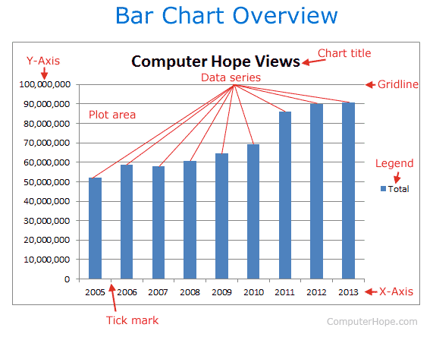
Bar Charts
Best used for
Comparing quantities across categories
Key insights:
Shows differences in each item clearly
Real world example:
Sales by product category

Slide 3
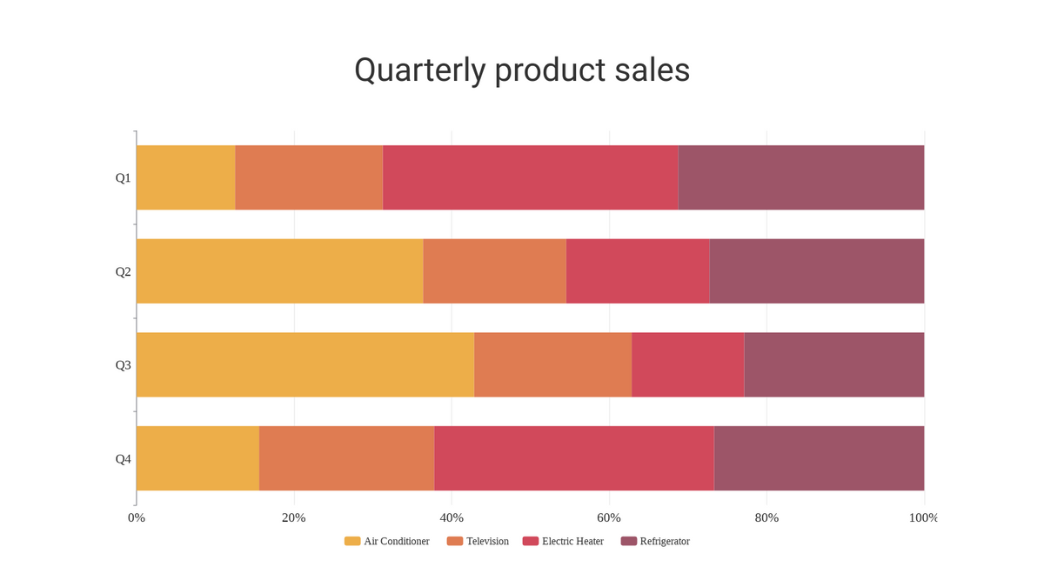
Stacked Bar Charts
Showing contribution of parts to a whole
Highlights category breakdown within total values
Department-wise budget breakdown within total company budget

Slide 4
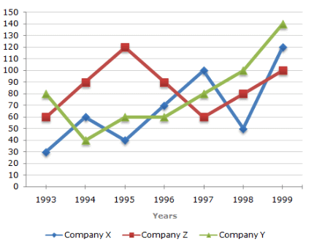
Line Charts
Trends over time
Shows growth, decline, and patterns
Website traffic trends for the last 12 months

Slide 5
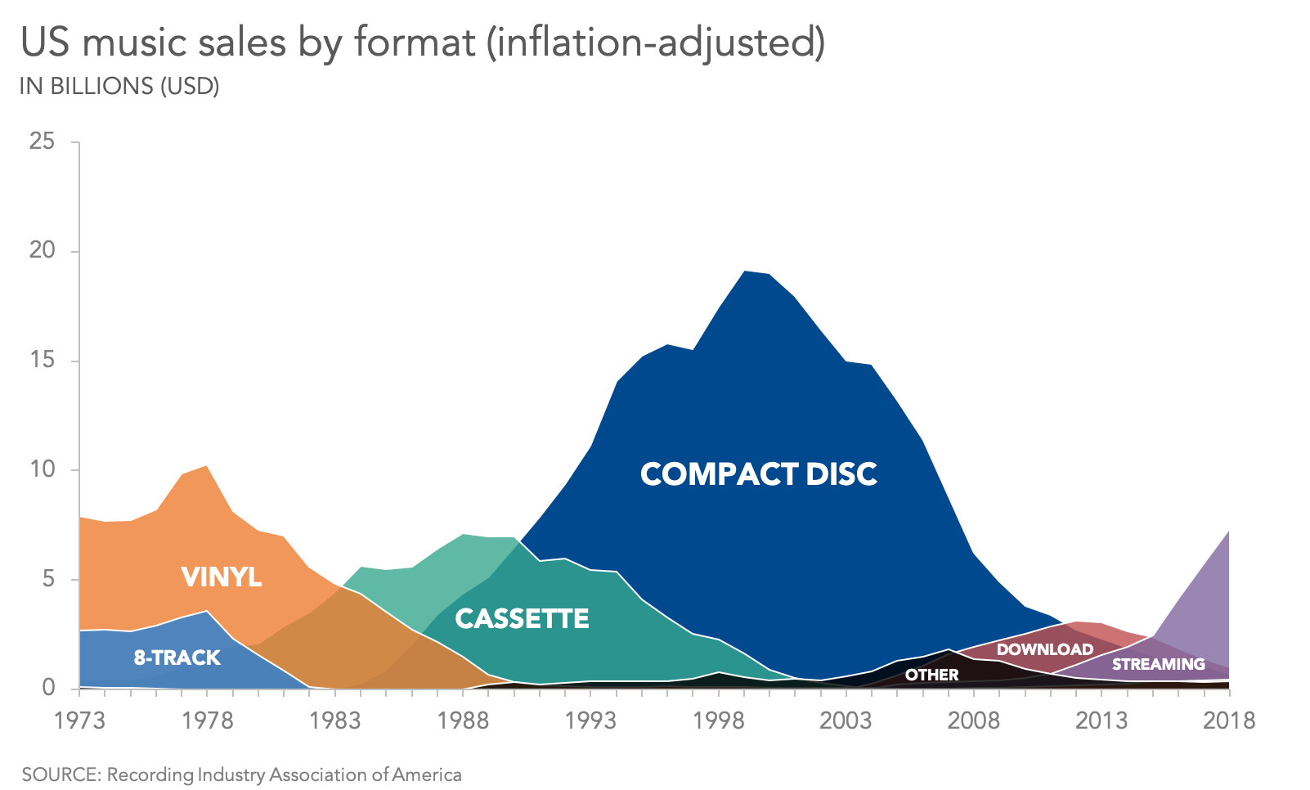
Area Charts
Cumulative trends over time
Emphasizes magnitude along with trend
Cumulative number of app downloads over time

Slide 6
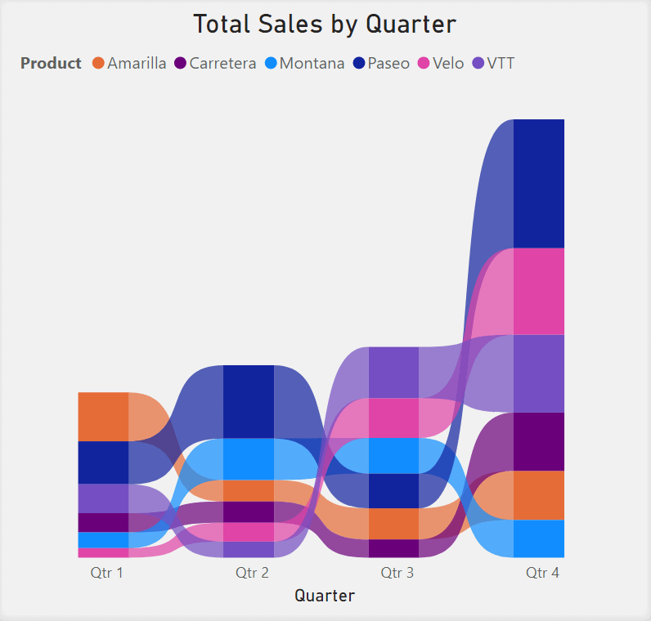
Ribbon Charts
Comparing ranking/position changes of categories over time
Shows which category leads at each point in time and how ranks shift
Market share of telecom operators over months (to see which operator goes from #3 → #1

Slide 7
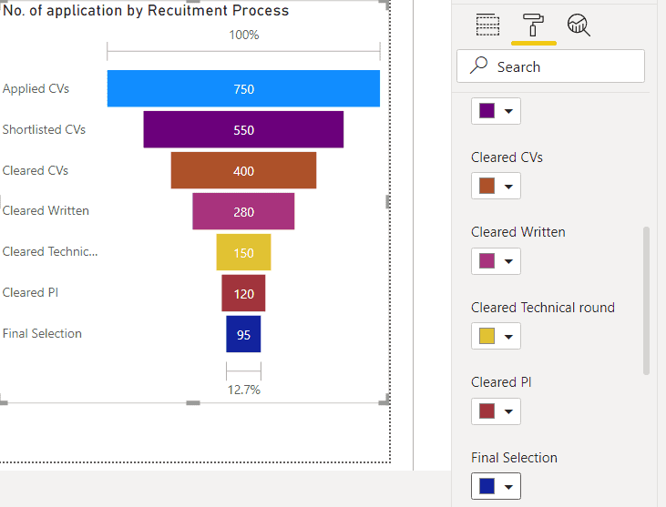
Funnel Charts
Analyze and visualize data
Examples can be—tracking applications, sales leads

Slide 8
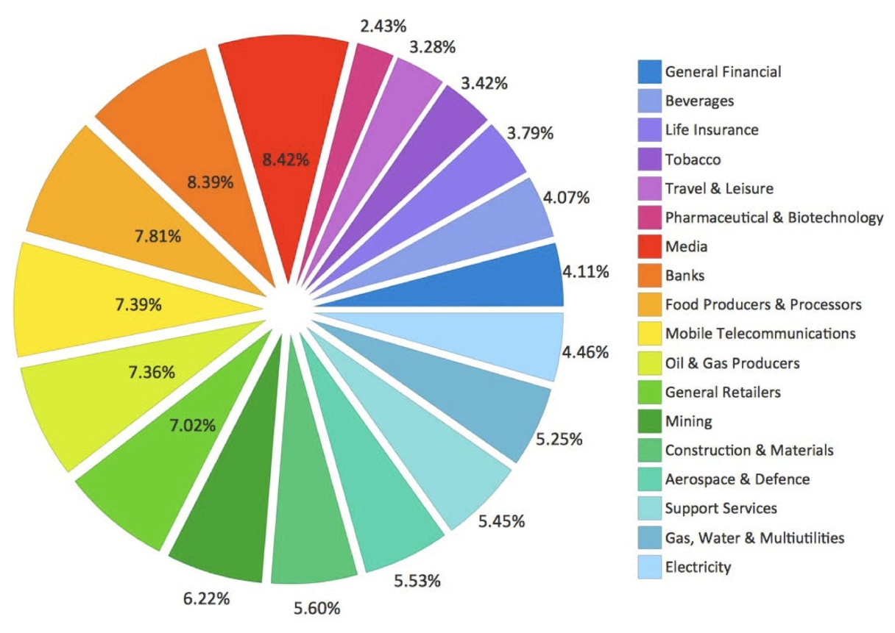
Pie Charts
Showing percentage share
Good for quick share comparison (use sparingly)
Market share of smartphone brands

Slide 9
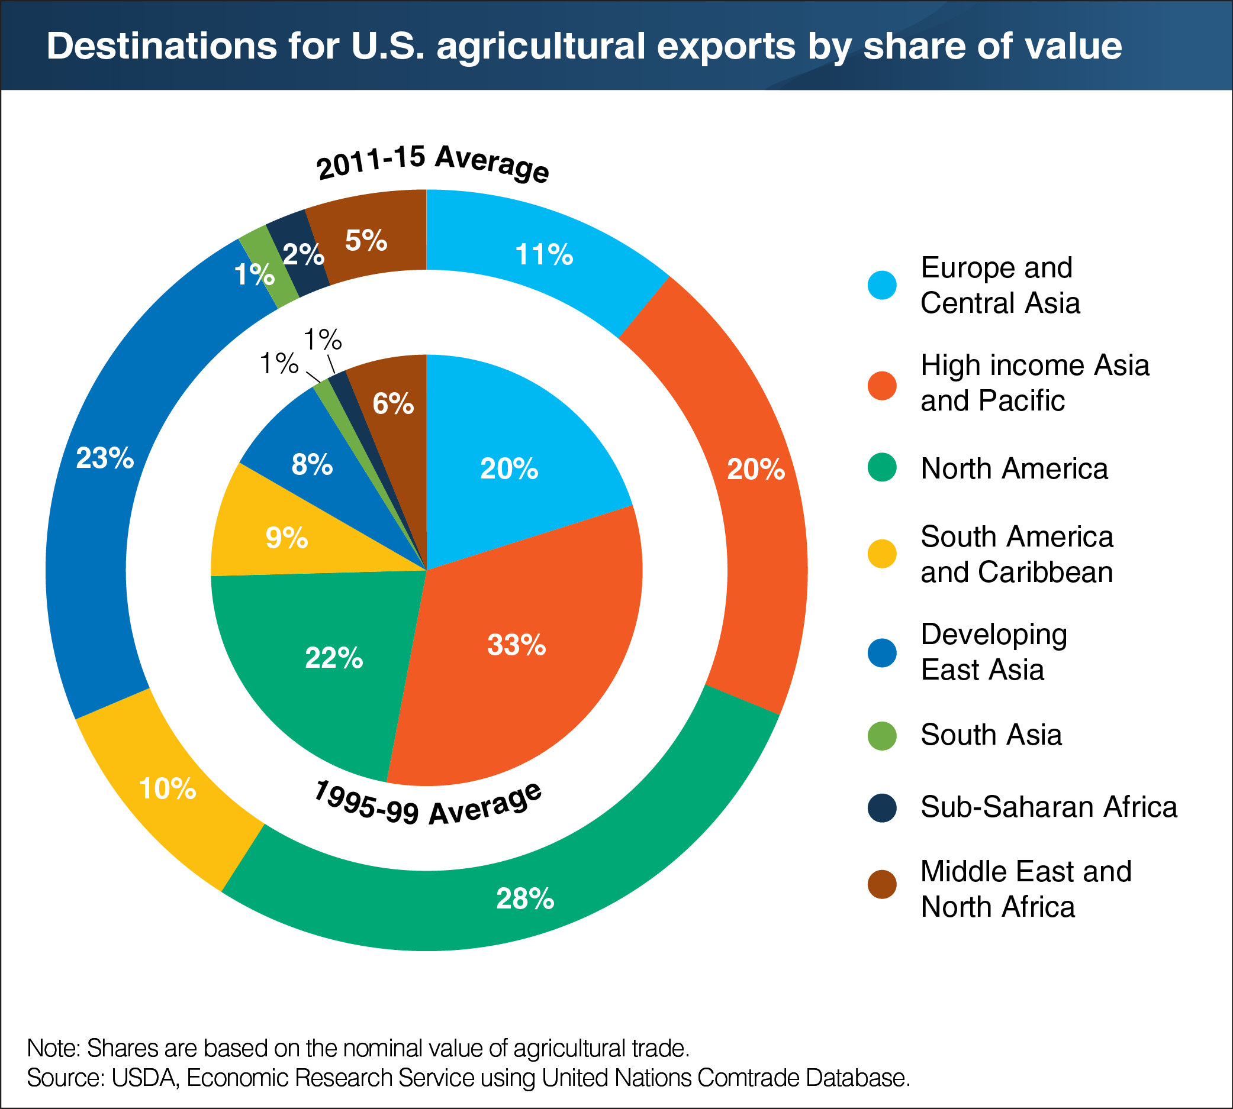
Donut Charts
Percentage share with center label
Similar to pie but space for labeling center
Customer type breakdown (new vs returning)

Slide 10
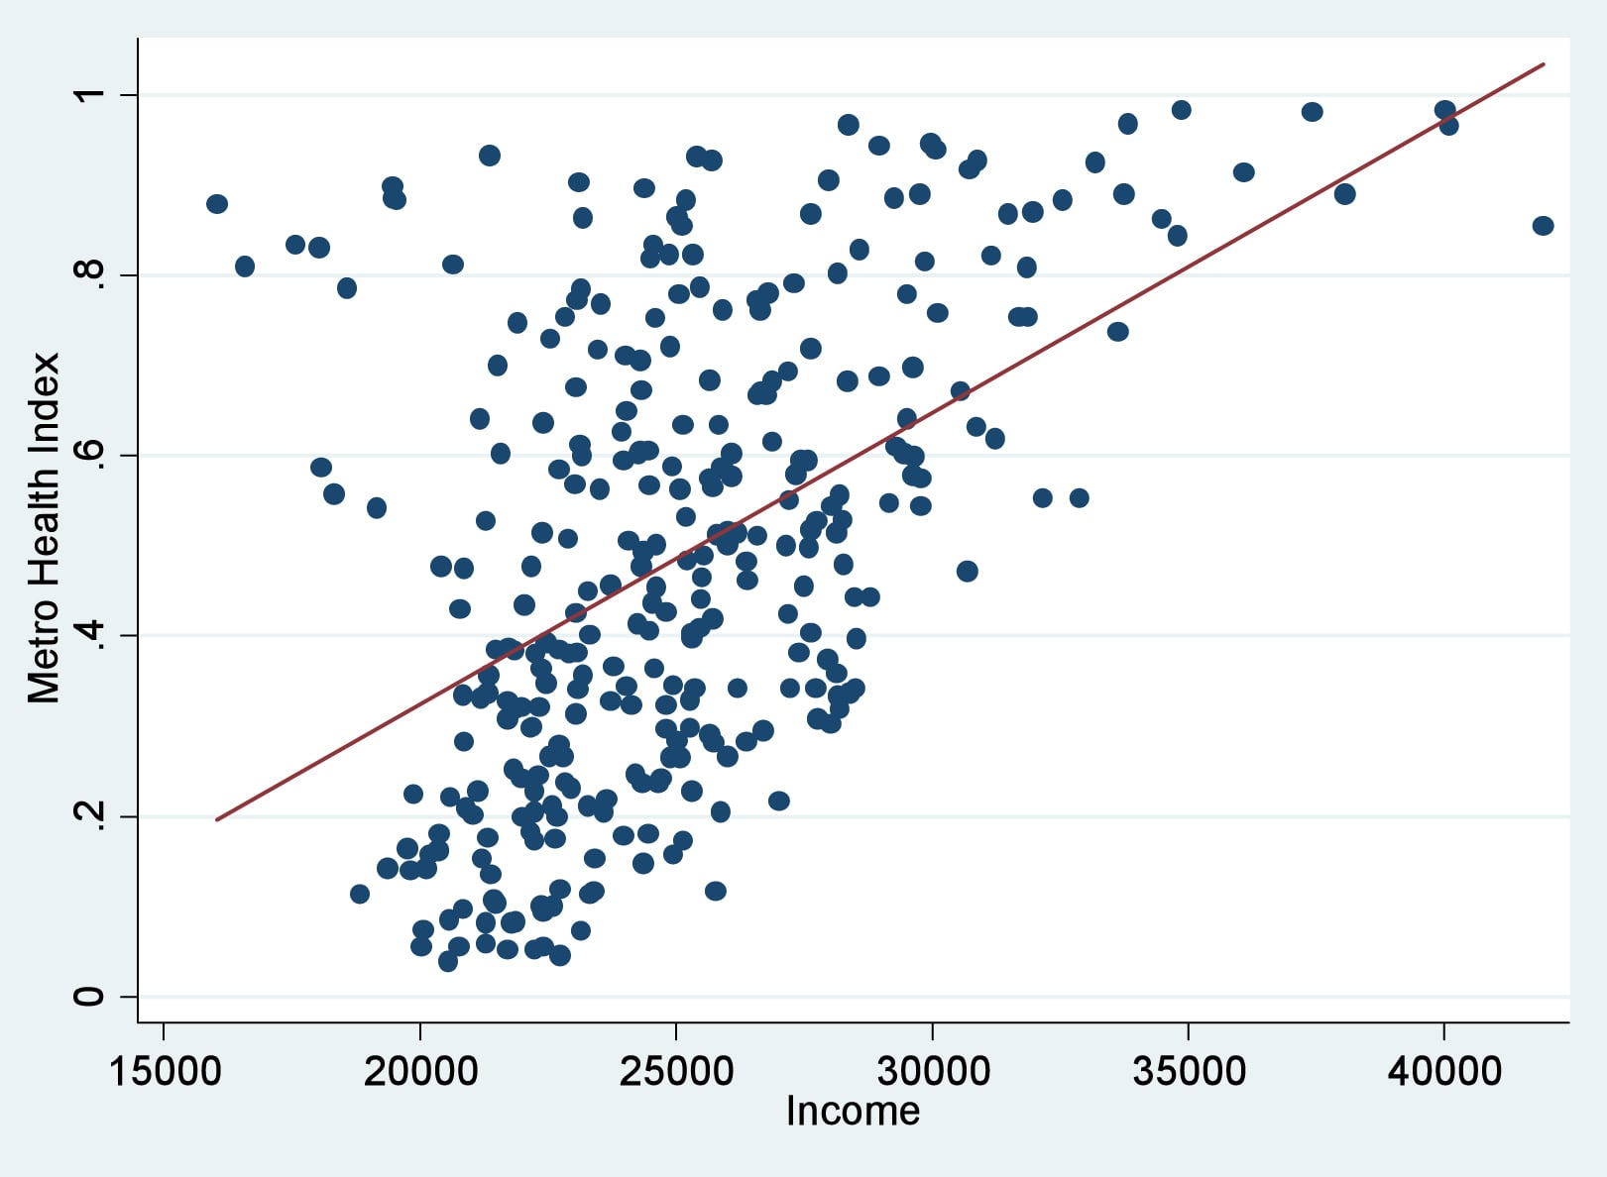
Scattered Plots
Relationship between two variables
Identifies correlations, clusters, and outliers
Relationship between ad spend and sales

Slide 11
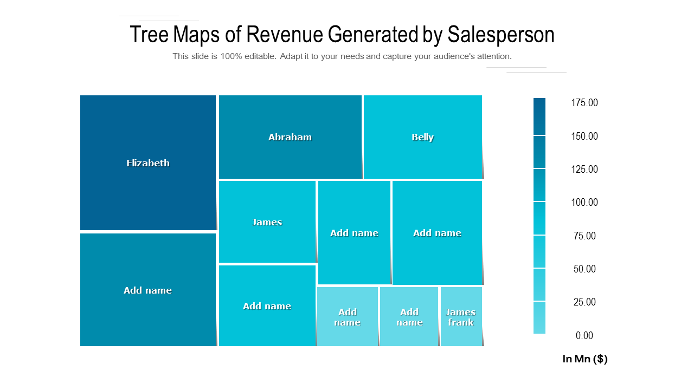
Tree Maps
Hierarchical data with size-based rectangles
Shows proportion and hierarchy in one view
Revenue contribution by product categories and subcategories

Slide 12
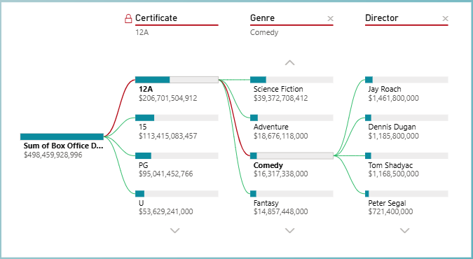
Decomposition Tree
Analyze and explain data
Drill down on a quantitative variable

Slide 13
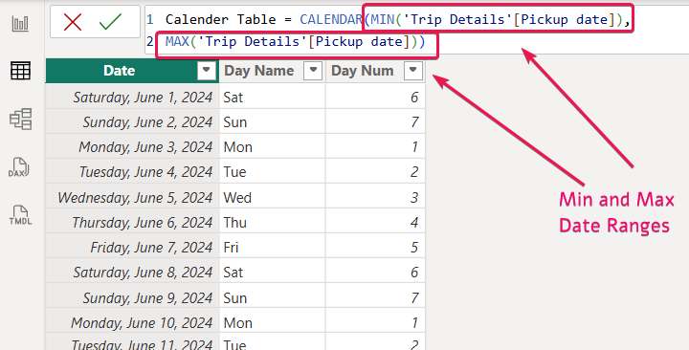
Adding a calendar
We deal with dates very frequently in our data models
Power BI makes it easy with the `CALENDAR` function
Use the minimum and maximum date rages from your data source

Slide 14
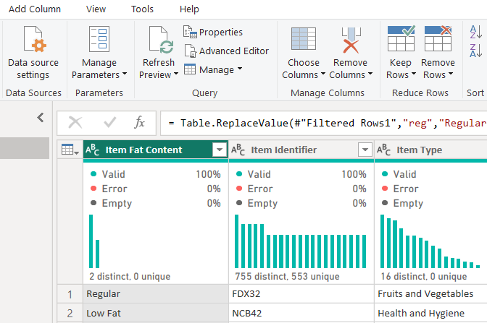
Data cleaning steps
Check for missing values
Check if categories are correct
Use Power BI helper functions
Look for trends, blank rows, column names

Slide 15
Learning Resources
Awesome resources we’ll use throughout the course
Resources:
WiseOwl.co.uk
Microsoft Fabric Community
GeekForGeeks
Powerbidocs.com
Dax.do

